Slide 1
Division

Slide 2
evenly
groups
each
remainder
between
Division
divisor
Repeated subtraction
average
share
quotient
divide

Slide 3
Division Calculation
Divided by equals
24 ÷ 6 = 4
dividend
divisor
quotient

Slide 4
Sharing using objects
12 ÷ 2= 6
We can work this out by splitting 12 teddy bears into 2 groups. This will give us our answer 6.

Slide 5
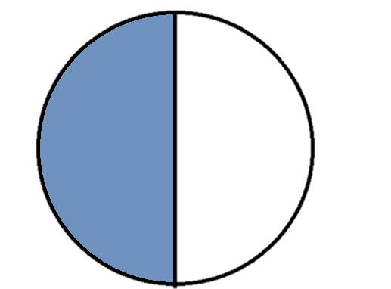
One half

Slide 6
Halving
Half:
16 = 8
Half:
2 = 1
4 = 2
6 = 3
5 + 3 = 8

Slide 7
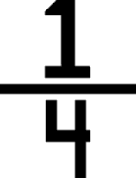
One quarter
A quarter as a fraction looks like this:
It means that 1 out of the 4 pieces has been coloured, or if the item is food, half could have been eaten.

Slide 8
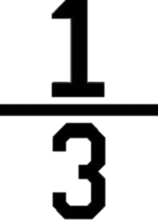
One third
1 third as a fraction looks like this:
It means that 1 out of the 3 pieces has been coloured, or if the item is food, half could have been eaten.

Slide 9
Repeated Subtraction
6 = -2-2-2
6 ÷ 2 = 3
12= -3-3-3-3
30= -5-5-5-5-5-5
Can you write the division sentences for these two repeated subtractions?

Slide 10
Arrays
2 x 3 = 6
6 ÷ 2 = 3
3 x 2 = 6
6 ÷ 3 = 2

Slide 11
Multiplication and
division facts
When multiplying and dividing you often use the same numbers . Below are some examples of this.
2x4=8
4x2=8
8÷2=4
8÷4=2
5x10=50
10x5=50
50÷5=10
50÷10=5
5x2=10
2x5=10
10÷2=5
10÷5=2
3x4=12
4x3=12
12÷3=4
12÷4=3

Slide 12
Multiplication Triangles
63
9x7=63
7x9=63
63÷7=9
63÷9=7
÷
÷
21
7
x
9
÷
÷
3x7=21
7x3=21
21÷3=7
21÷7=3
7
x
3

Slide 13
Division by grouping
32÷4=8

Slide 14
Division by grouping
27÷3=9
3
3
3
3
3
3
3
3
3

Slide 15
Division by grouping
25÷3=8r1
3
3
3
3
3
3
3
3
1

Slide 16
Division by chunking
78 ÷ 6 = 13
60
18
10 + 3 =13

Slide 17
Division- short formal
method
1 3
1 3 r1
6 7 8
1
6 7 9
1
1 2 .5
3
6 7 5.0
1

Slide 18
Long Division
by chunking
312 ÷ 12 = 26
72
20 + 6 = 26

Slide 19
Long Division
by chunking
12 312
-240 (20 x 12)
72
-72 (6 x 12)
0

